Slide 1
Python Programming Language Foundation
Session 7
Notes:
1

Slide 2
Session overview
Exceptions
Context managers
Iterators
Generators
Python Programming Solutions ©
2
Notes:
2

Slide 3
Exceptions
Python Programming Solutions ©
3

Slide 4
Exceptions
An event,
which occurs during the execution of a program that disrupts the normal flow of the program's instructions
Python object
that represents an error situation
There are (at least) two distinguishable kinds of errors: syntax errors and exceptions
It is possible to write programs that handle selected exceptions
Python Programming Solutions ©
4

Slide 5
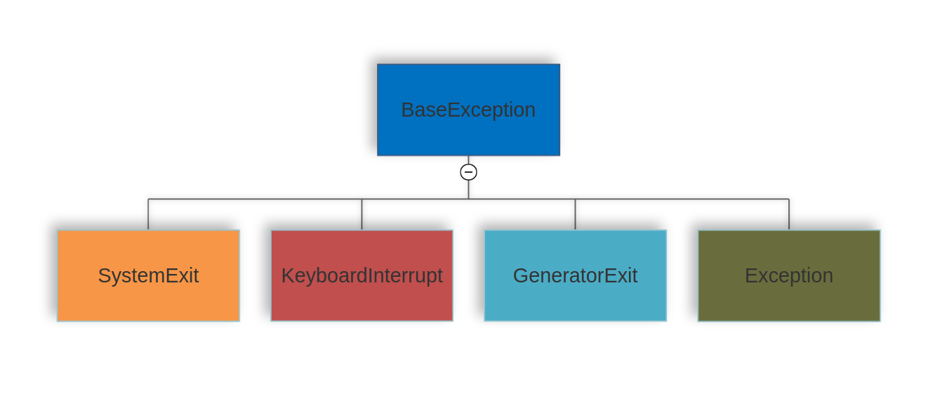
Standard exception hierarchy
https://docs.python.org/3/library/exceptions.html#exception-hierarchy​
Python Programming Solutions ©
5

Slide 6
Standard exception hierarchy
StopIteration
StopAsyncIteration
ArithmeticError
AssertionError
AttributeError
BufferError
EOFError
ImportError
LookupError
MemoryError
NameError
OSError
ReferenceError
RuntimeError
SyntaxError
SystemError
TypeError
ValueError
Warning
https://docs.python.org/3/library/exceptions.html#exception-hierarchy​
Python Programming Solutions ©
6

Slide 7
Standard exception hierarchy
StopIteration
StopAsyncIteration
ArithmeticError
AssertionError
AttributeError
BufferError
EOFError
ImportError
LookupError
MemoryError
NameError
OSError
ReferenceError
RuntimeError
SyntaxError
SystemError
TypeError
ValueError
Warning
https://docs.python.org/3/library/exceptions.html#exception-hierarchy​
Python Programming Solutions ©
7

Slide 8
Exception generation
raise [exception_type|exception_object]
Python Programming Solutions ©
8
Notes:
8

Slide 9
Handling exceptions
try: ... # You do your operations here except Exception1: ... # Exception1 has been raised except Exception2: ... # Exception2 has been raised else: ... # No exceptions has been raised finally: ... # Always executed no matter what
Python Programming Solutions ©
9
Notes:
9

Slide 10
Handling multiple exceptions in a same manner
try: ... # You do your operations here except (Exception1[, Exception2[, ...]]) as err: ... # Any exception from the given list has been raised
Python Programming Solutions ©
10
Notes:
10

Slide 11
Exception re-raising
raise [exception_type|exception_object]
Python Programming Solutions ©
11
Notes:
11

Slide 12
Custom exceptions
class CustomException(exception_type)
Python Programming Solutions ©
12
Notes:
12

Slide 13
Best practice
except Exception as exc
raise Exception from exc
Specify types of caught exceptions
Use finally and else blocks
Python Programming Solutions ©
13

Slide 14
Iterators
Python Programming Solutions ©
14

Slide 15
Iterable & Iterator
Iterable
Iterator
Python Programming Solutions ©
15
Notes:
15

Slide 16
Iterable
An object capable of returning its members one at a time
https://docs.python.org/3/glossary.html#term-iterable​
Python Programming Solutions ©
16

Slide 17
Iterable examples
list/tuple
str
tuples
File objects
https://docs.python.org/3/glossary.html#term-iterable​
Python Programming Solutions ©
17

Slide 18
Iterable implementation
__iter__
https://docs.python.org/3/glossary.html#term-iterable​
Python Programming Solutions ©
18

Slide 19
Iterator
An object representing a stream of data. Repeated calls to the iterator’s __next__() method return successive items in the stream
https://docs.python.org/3/glossary.html#term-iterable​
Python Programming Solutions ©
19

Slide 20
Iterator
A class that wants to be an iterator should implement two methods: a __next__() method, and an __iter__() method that returns self
https://docs.python.org/3/glossary.html#term-iterable​
Python Programming Solutions ©
20

Slide 21
How does it work?
for statement
Iterator
iter()
next()
StopIteration
Element
next()
https://docs.python.org/3/glossary.html#term-iterable​
Python Programming Solutions ©
21

Slide 22
Generators
Python Programming Solutions ©
22

Slide 23
Generator
Generator is a kind of iterator which does not know anything about collection he iterates, only how to create next element (e.g. generates)
https://www.python.org/dev/peps/pep-0255/
Python Programming Solutions ©
23

Slide 24
Generator function
It looks like a normal function except that it contains one or more yield expressions
https://docs.python.org/3/glossary.html#term-generator​
Python Programming Solutions ©
24

Slide 25
Generator definition
def function_name([arguments]): [function_expression]
yield_expression
[function_expression]
Python Programming Solutions ©
25
Notes:
25

Slide 26
Context Managers
Python Programming Solutions ©
26

Slide 27
Context manager
A context manager is an object that defines the runtime context to be established when executing a `with` statement
Python Programming Solutions ©
27
Notes:
27

Slide 28
Context manager
Context manager as a class
Context manager as a function
Python Programming Solutions ©
28
Notes:
28

Slide 29
`with` statement
with context [as target]:
# code block
Python Programming Solutions ©
29
Notes:
29

Slide 30
Context manager as class
__enter__
__exit__
Python Programming Solutions ©
30
Notes:
30

Slide 31
Context manager as a function
@contextmanager
def function_name([arguments]): [function_expression]
yield_expression
[function_expression]
Python Programming Solutions ©
31
Notes:
31

Slide 32
Definition
contextlib.
contextmanager
asynccontextmanager
closing
nullcontext
suppress
redirect_stdout
redirect_stderr
https://docs.python.org/3/library/contextlib.html​
Python Programming Solutions ©

Slide 33
Some popular use cases
Etc.
Reading from / writing to files
Manipulating database connections
Usage of synchronization primitives in multitasked applications
Temporary patching of some objects (unit tests)
Python Programming Solutions ©
33
Notes:
34

Slide 34

Thanks for attention
Questions?
Python Programming Solutions ©
34
Notes:
34

